Slide 1
Image server with rest api
Saúl Almazán del Pie
Marina Alonso-Cortés Lladó
Jorge Santisteban Rivas

Slide 2
Purpose
Create an image server that provides a REST API for:
Creating new users (each user should have a unique id and a name).
Listing the users in the system.
Uploading .jpg images to a user's online storage space (each image should have a unique key and a title).
Listing the available images by user id.
Obtaining the images from the server.

Slide 3
Flask
Flask is a "micro" Framework written in Python and conceived to facilitate the development of Web Applications under the MVC pattern.
The MVC pattern is a way or a way of working that allows us to differentiate and separate:
The data model (the data that the App is going to have that are normally stored in BD)
The view (HTML page)
The controller ( where the requests of the web app are managed).

Slide 4
Data model
We will use to store the data a SQLite database, using 2 extensions for Flask:
Flask-SQLAlchemy: Helps us to manage SQLite databases.
Flask-MIgrate: It provides us the opportunity to save all versions of our database (migrations).
The data that will be stored in the database will be represented by a collection of classes, called database models. We will define them in models.py.
In the database models we find 2 main classes:
User
Post
They will be stored in app.db

Slide 5
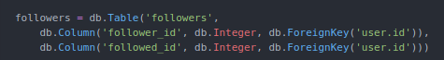
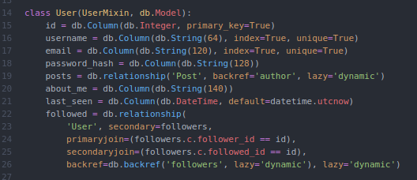
User parameters

Slide 6
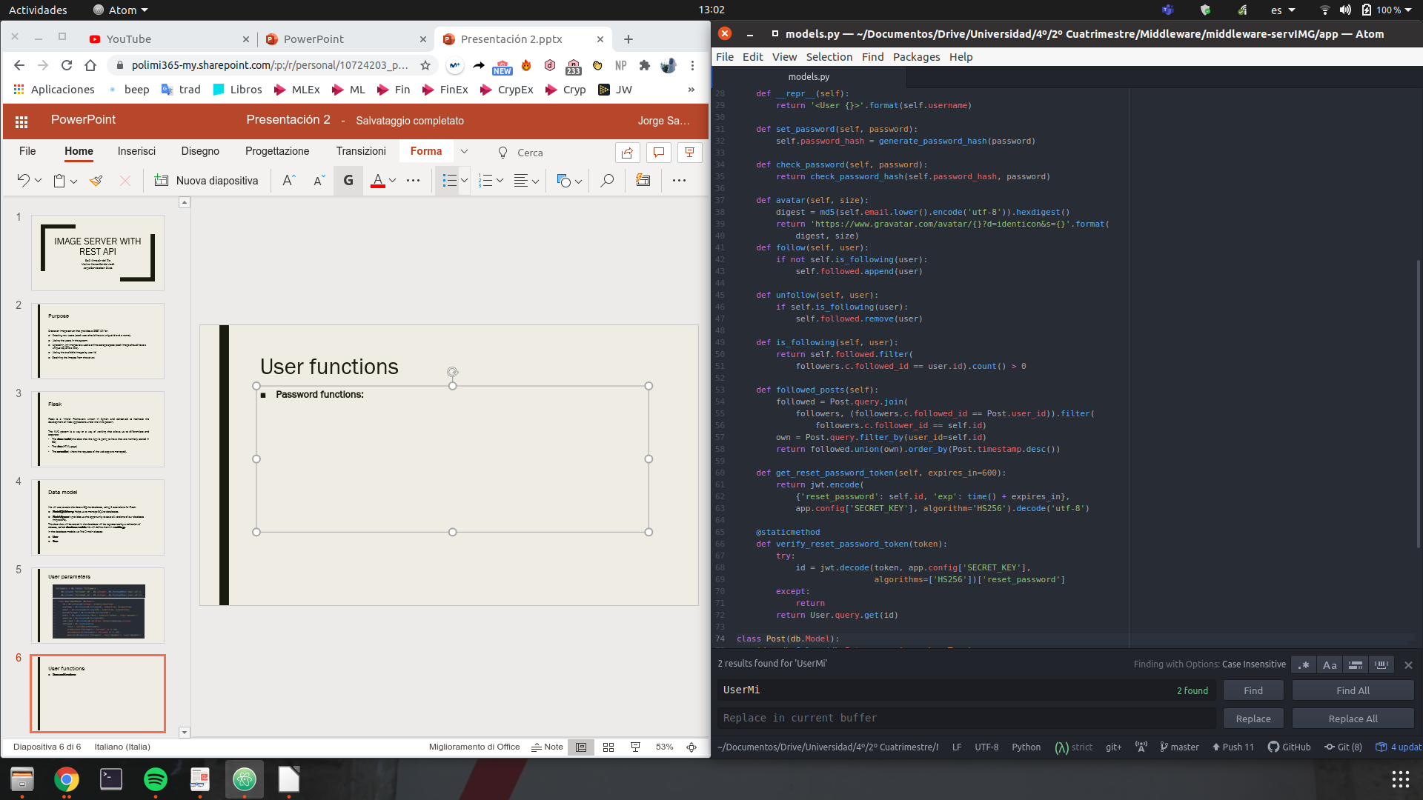
User functions
Password functions: We will use 2 functions from the werkzeug module:
Generate_password_hash
Check_password_hash

Slide 7
User functions
Avatar function: This function returns a random image based on the email address using the md5 module:

Slide 8
User functions
Follow functions: We can find 4 different functions defined for different tasks:
Is_following
Follow
Unfollow
Followed_posts

Slide 9
User functions
Reset password functions: We have defined 2 functions used for resetting the user's password. To generate the tokens we use the pyjwt module:
Get_reset_password_token: It uses the encode function
Verify_reset_password_token: It uses the decode function

Slide 10
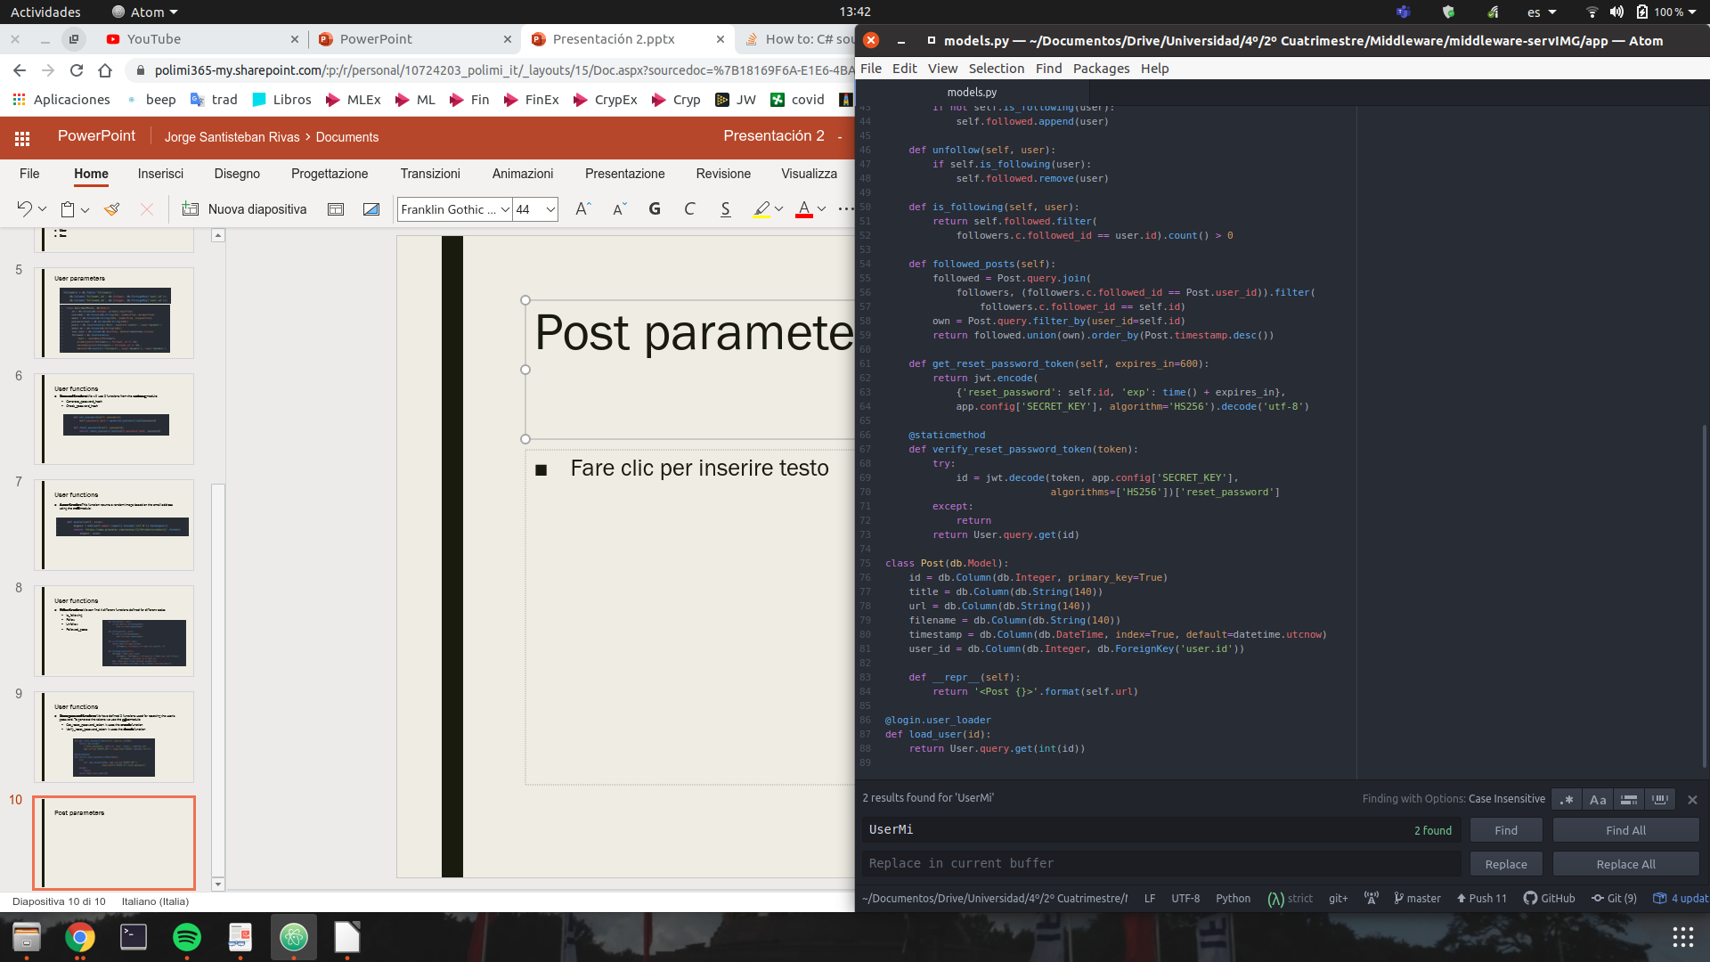
User functions
Login function: The module used for login needs the application's help in loading a user. We need to load a user given its id, so we define:

Slide 11
Post parameters

Slide 12
Migrations
To keep track on migrations we should run the following commands:
Flask db init: We create the migration repository
When we do some changes in models.py (either in User or in Post), to upgrade the database we should run:
1º flask db migrate -m "subject of the change"
2º flask db upgrade

Slide 13
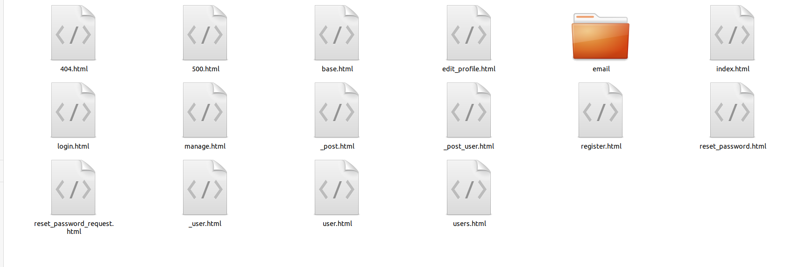
View
For the view we have designed several html pages that will act as the view of our system. To give the server a fresh air we have used a CSS framework called Bootstrap. To be able to use it with Flask we have used the module Flask-bootstrap.

Slide 14
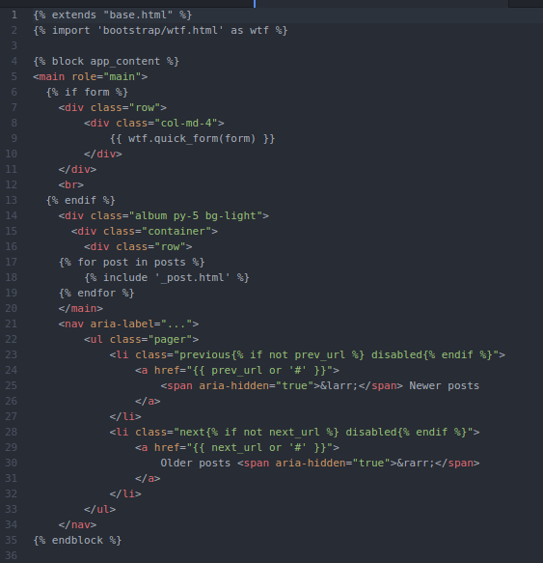

Slide 15
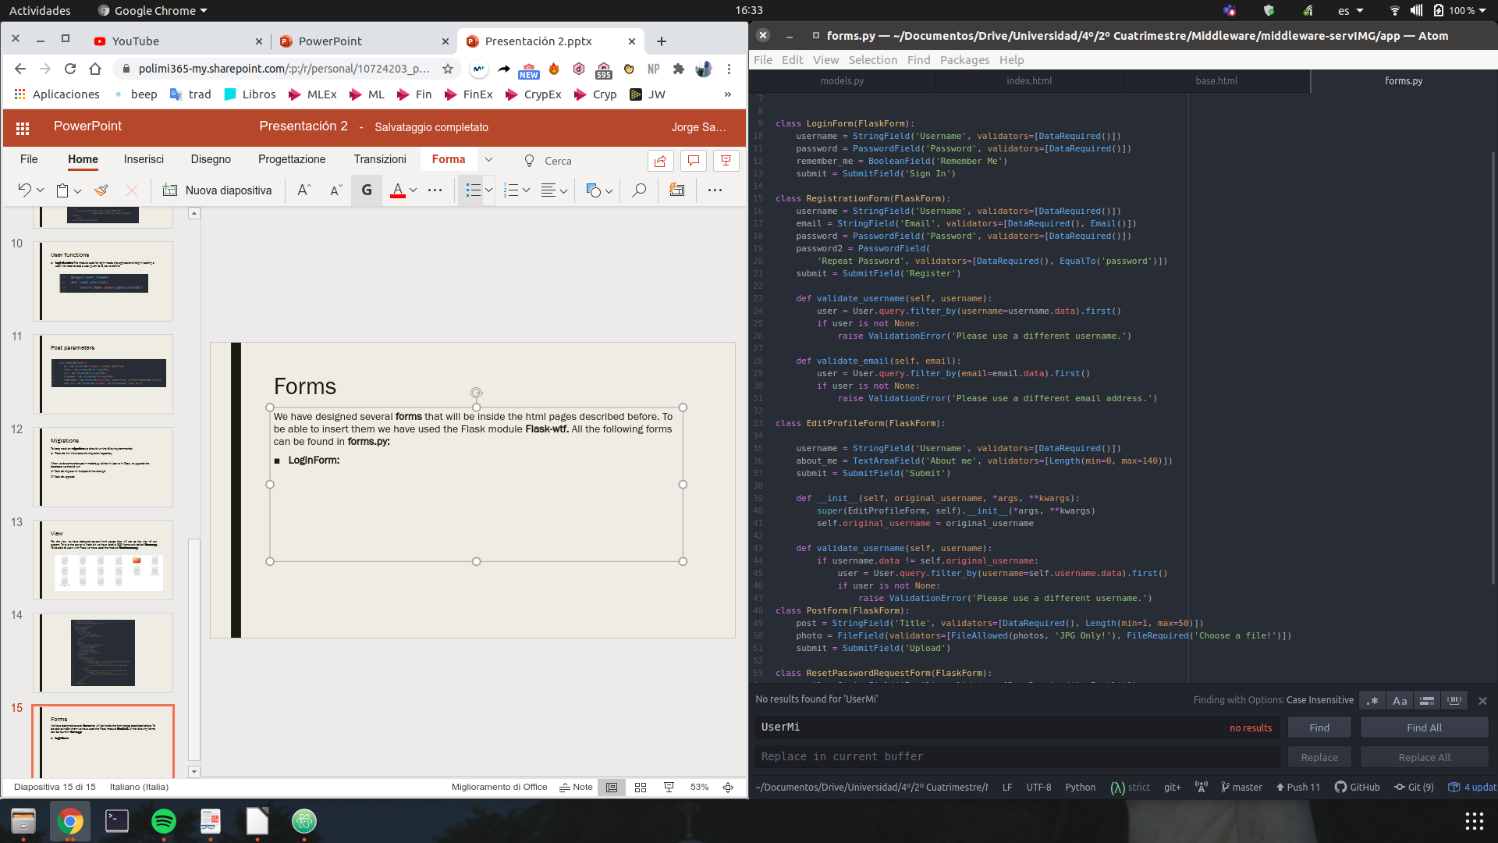
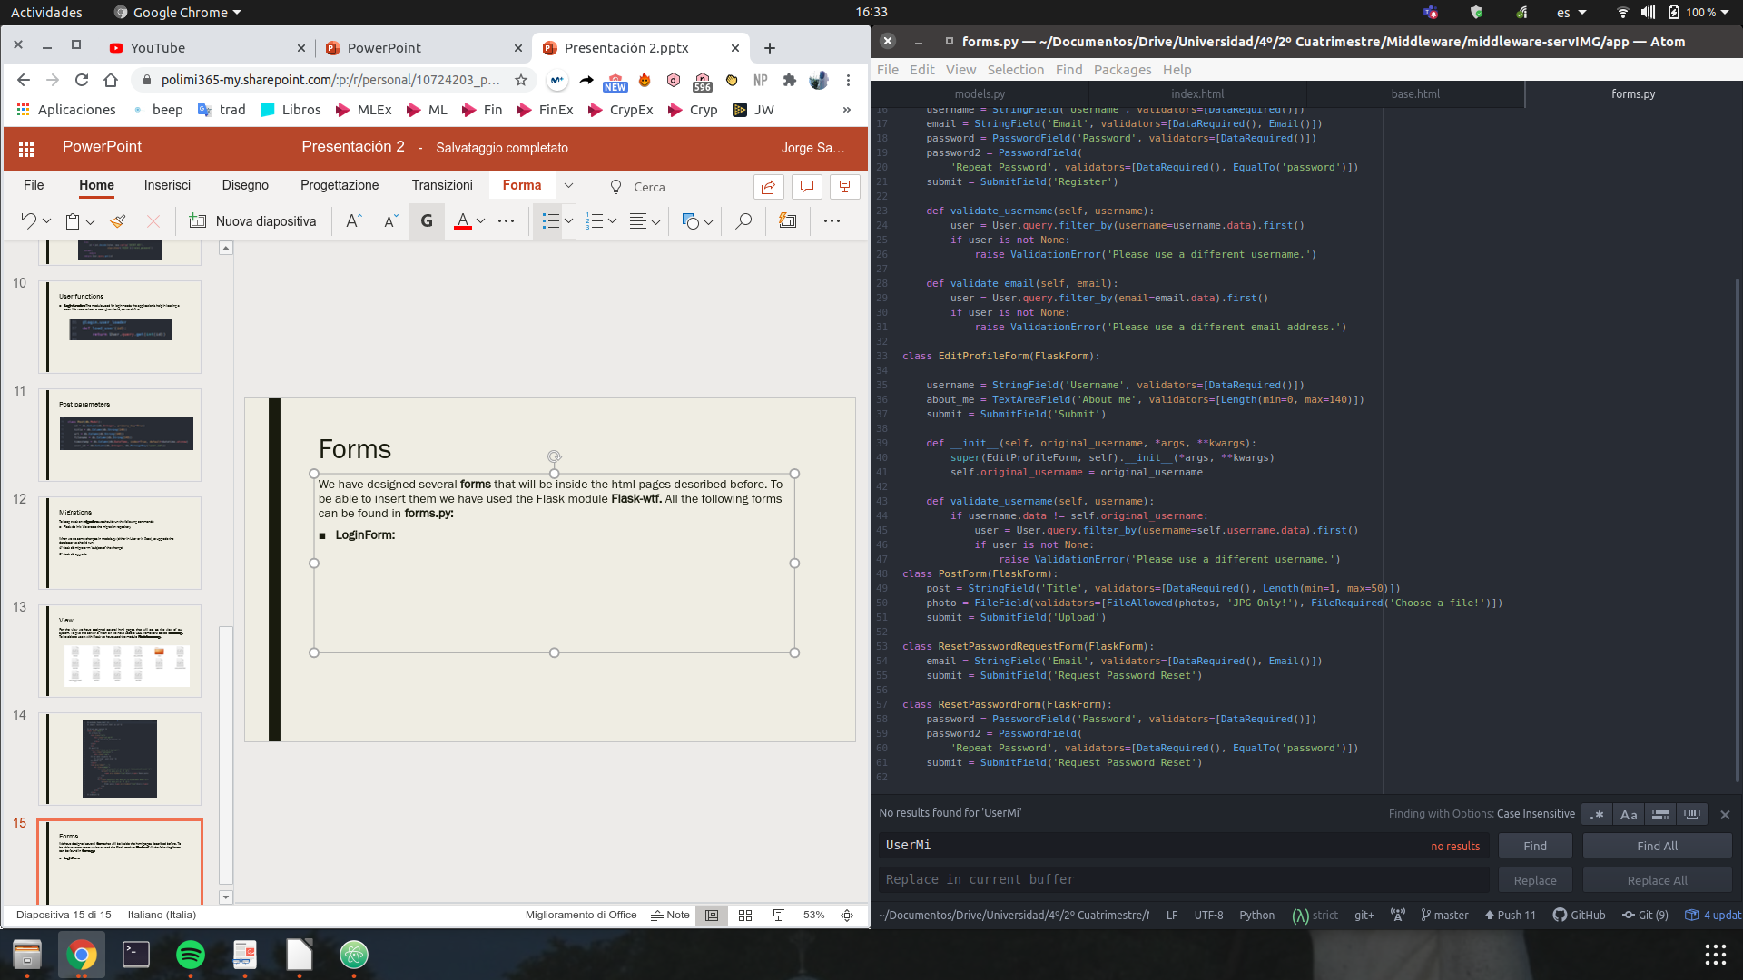
Forms
We have designed several forms that will be inside the html pages described before. To be able to insert them we have used the Flask module Flask-wtf. All the following forms can be found in forms.py:
LoginForm:
PostForm:

Slide 16
Forms
RegistrationForm: Apart from the parameters if the form we will create two functions for: validating the username and validating the email.

Slide 17
Forms
EditProfileForm: We define a custom validation method with an overloaded constructor that accepts the original username as an argument. This fixes the duplicate username bug that we may have editting the username.

Slide 18
Forms
ResetPasswordRequestForm
ResetPasswordForm

Slide 19
Controller
Now that we have seen the model and the view we need to "link" them. For doing that we will define all possible paths in routes.py.
We will have a route for all the events our server wants to cover:
Login and logout an user
Register in the system
See users in the system
Edit user's profile
Follow and unfollow users
Manage user images
Reset user's password

Slide 20
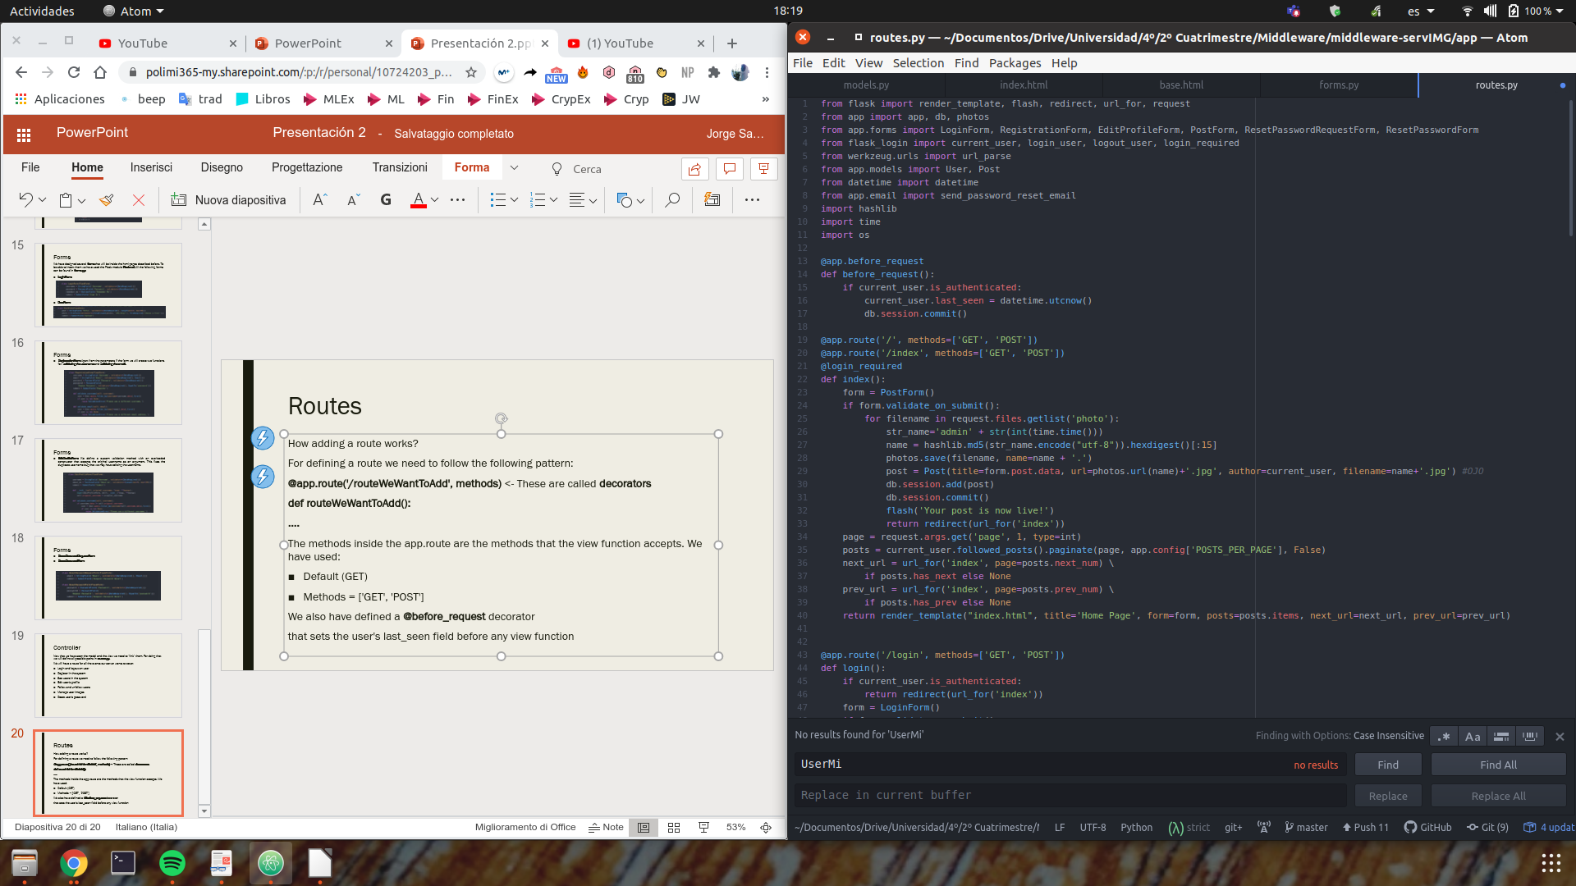
Routes
How adding a route works?
For defining a route we need to follow the following pattern:
@app.route('/routeWeWantToAdd', methods) <- These are called decorators
def routeWeWantToAdd():
Parameters used … <- For forms that need to be submitted we will use form.validate_on_submit()
return render_template() <- This functions shows the html giving it the needed parameters
The methods inside the app.route are the methods that the view function accepts. We have used:
Default (GET)
Methods = ['GET', 'POST']
We also have defined a @before_request decorator
that sets the user's last_seen field before any view
function

Slide 21
/index, /
This is the default route of our server. For access this route we need to check that the user has logged in the system, adding the decorator @login_required. If the user hasn't done it we will redirect it directly to /login. Here we can find the following elements:
A post form
A pagination argument
The posts uploaded by the user's followed users.
Arrows for going to the previous page and next page.

Slide 22
/index, /

Slide 23
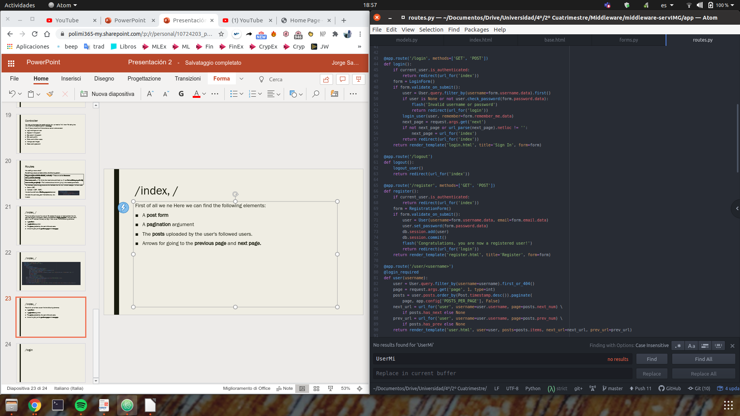
/login
First of all we need to check if anybody has logged in before. If so we redirect to the index site using the redirect function. Here we can find the following elements:
A login form: Here we will use the Flask module Flask_login

Slide 24
/logout
In this route we just the function logout_user defined in Flask_login.

Slide 25
/user/<username>
First of all we need to check if anybody has logged in before. Depending on the username parameter we will show the following information related to that user:

Slide 26
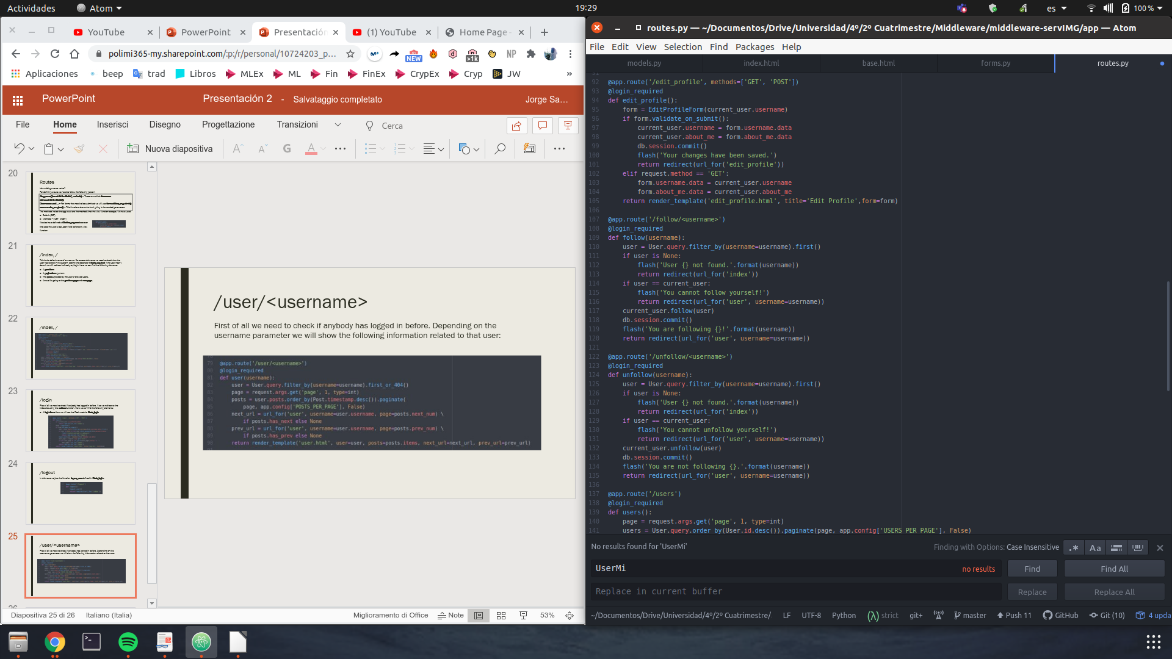
/edit_profile
First of all we need to check if anybody has logged in before. Here we can find the following elements:
An edit profile form

Slide 27
/follow/<username> and /unfollow/<username>
For these 2 routes we need to be logged in in the system and they work in the following way:

Slide 28
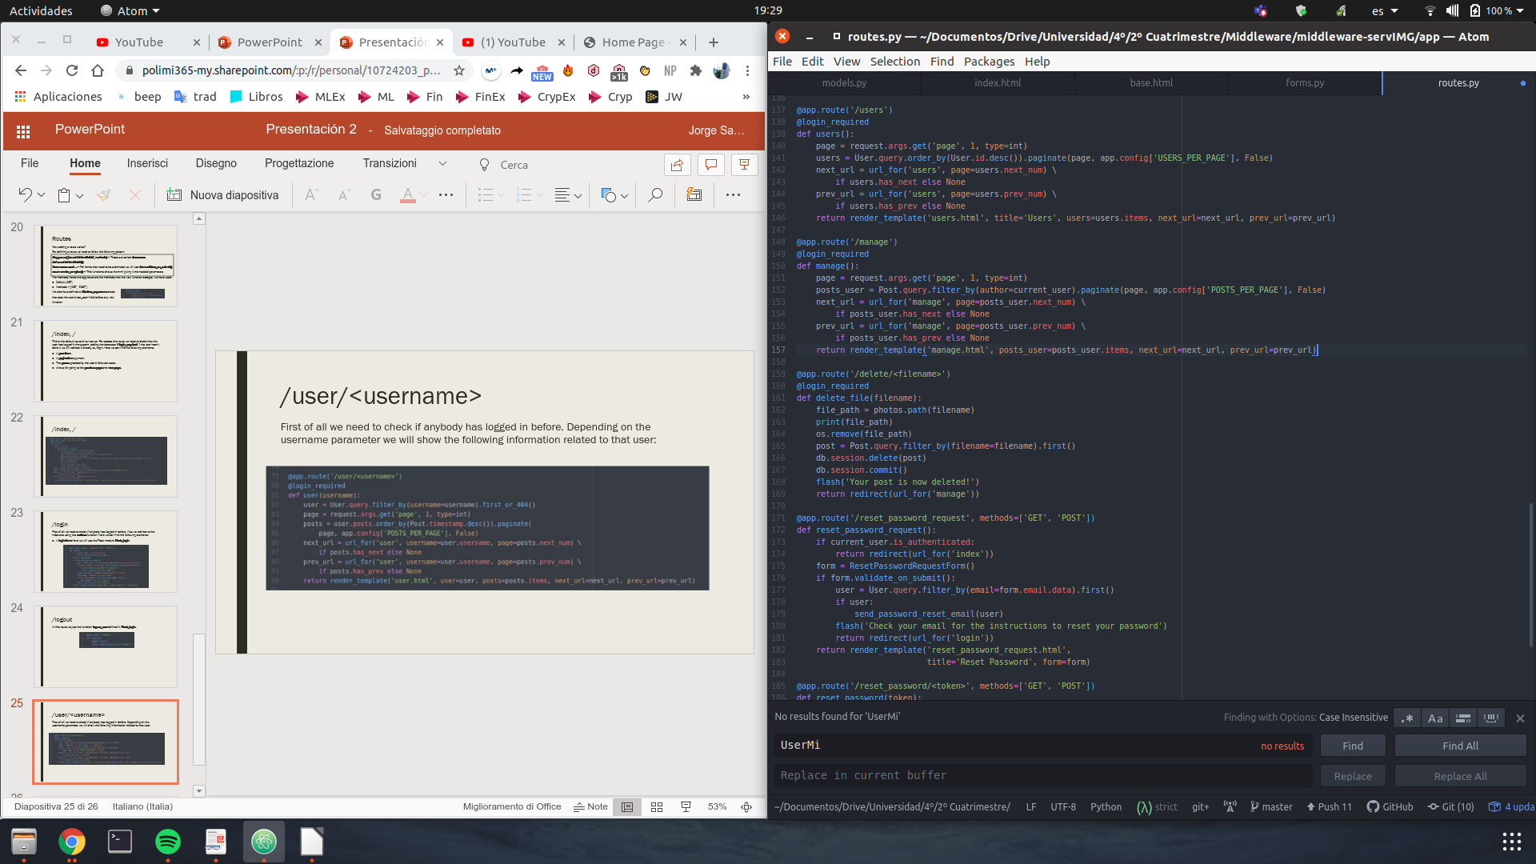
/users
First of all we need to check if anybody has logged in before. We will show all the users listed in the system in a paginated way:

Slide 29
/manage
First of all we need to check if anybody has logged in before. We will be able to manage the pictures we have upload to the server:

Slide 30
/delete/<filename>
First of all we need to check if anybody has logged in before. We will be able to delete a selected picture from the server:

Slide 31
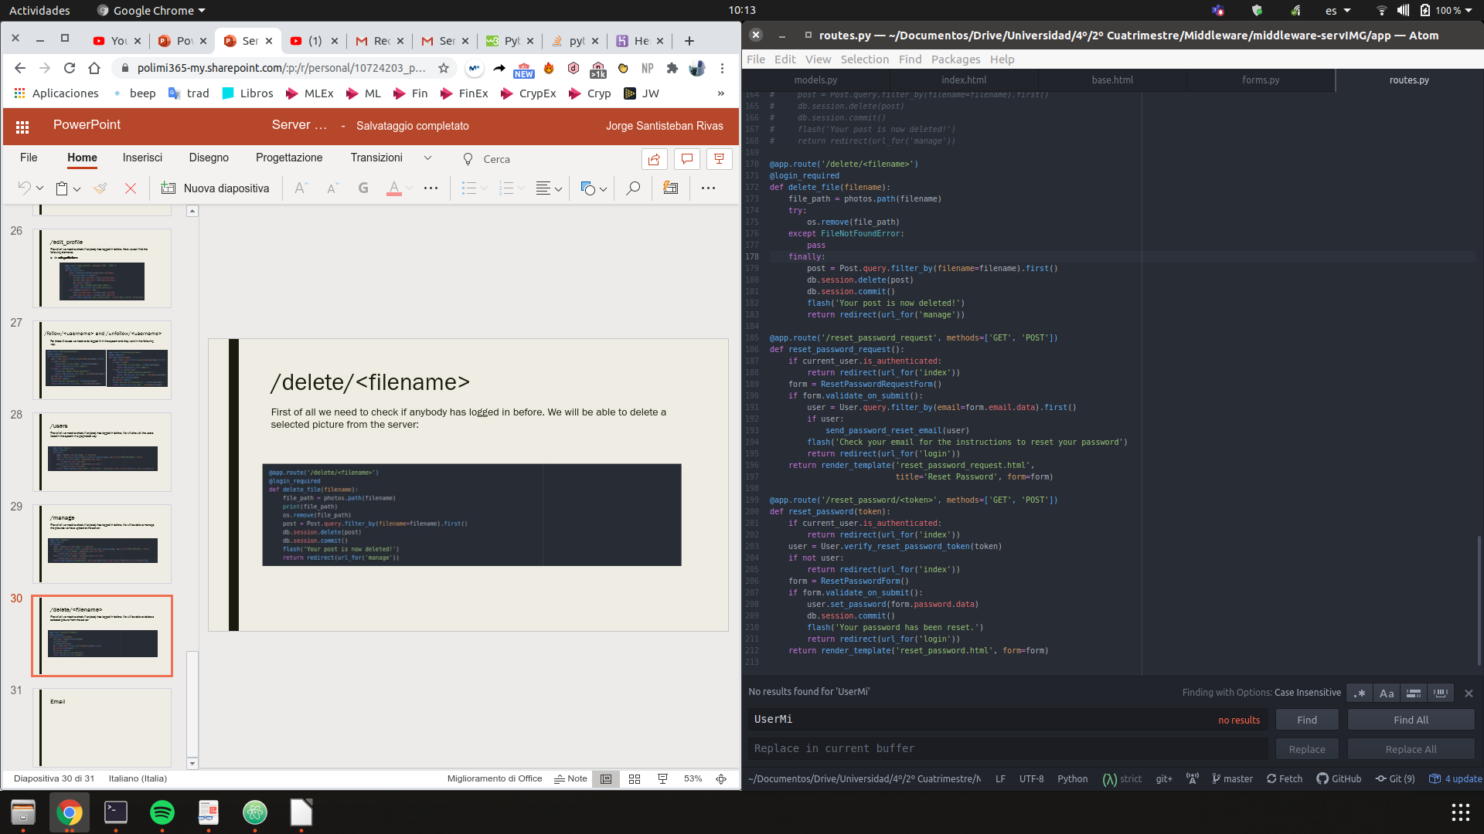
/delete/<filename>
For deployment reasons we will add a try/except/finally clause to properly delete the files:

Slide 32
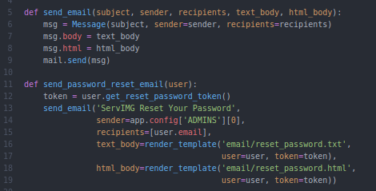
Email
Before analysing the last 2 routes we will talk about the recovery password module we have designed. We use the Flask module Flask-Mail. We can find in email.py the 2 functions used for sending mails:

Slide 33
/reset_password_request
We first need to check if the user is authenticated, because if it is we will redirect it to the index. If not we will show a ResetPasswordRequestForm:

Slide 34
/reset_password/<token>
We first need to check if the user is authenticated, because if it is we will redirect it to the index. Also we will check if the token is correctly assigned. If so we will show a ResetPasswordForm:

Slide 35
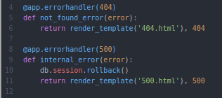
Errors handling
Custom error pages: We have defined 2 error handlers for 404 and 500 errors. We will define them in errors.py

Slide 36
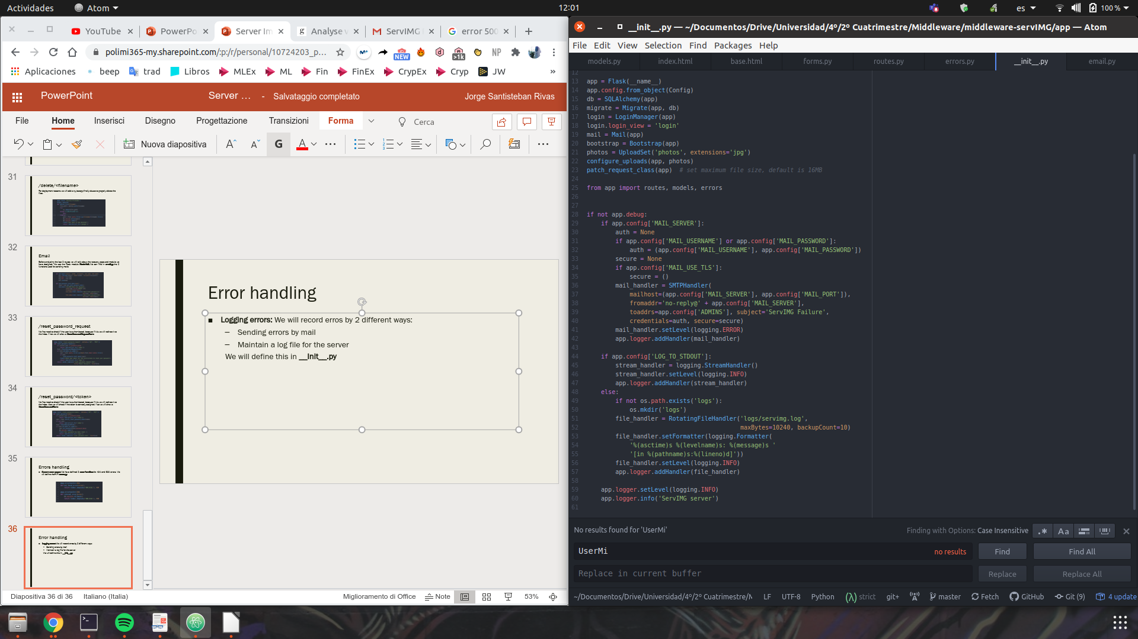
Error handling
Logging errors: We will record erros by 2 different ways:
Sending errors by mail
Maintain a log file for the server
We will define this in __Init__.py

Slide 37
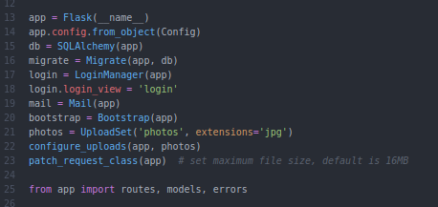
Combining everything
We will combine everything using 3 files:
__init__.py: A required file that makes the app a package in Python. It defines the symbols the package exposes to the outside. We have also defined here the log system explained before.

Slide 38
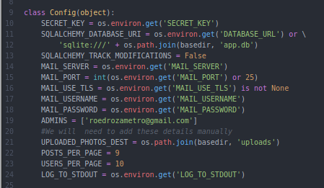
Combining everything
Config.py: In this file we will define all the variables that we will use all along the server.

Slide 39
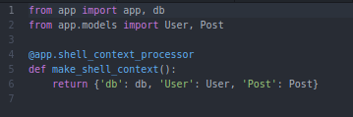
Combining everything
RestImgAPI.py: This is a Python script that defines the Flask application instance.

Slide 40
Deployment on Heroku
To deploy our server we have used Heroku, a third-party cloud hosting provider. Deploying a web application to Heroku is done through the git version control tool, so we just need to add our application to a git repository. To deploy correctly our service we will need 2 files:
A procfile: It contains instructions on how to start the application. We will just need to add this line:
web: flask db upgrade; gunicorn restImgAPI:app
First we start the database migration and we start the server using gunicorn
A requirements.txt: A file that lists all the module dependencies that need to be installed (such as wtf-forms, flask-mail...)
Having this 2 documents we will be able to deploy our server without any problem. But we can have some issues:
Permanent database -> Solved using a free add-on Heroku provides
A storage space for the images -> Heroku has an ephemeral file system (for storing them online we will have to pay!)

